Slide 1

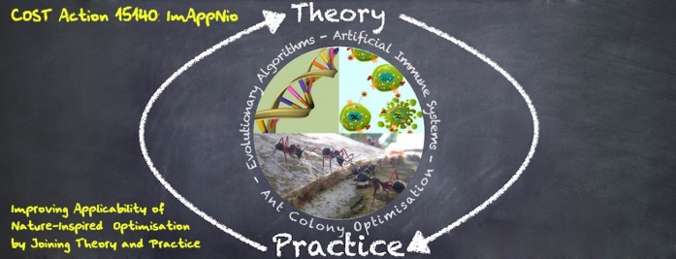

Introduction to ML
Alberto TONDA, INRA(E), Université Paris-Saclay France

Slide 2
Objectives
Obtain general understanding of ML
Get practical advice on algorithms
Highlight case studies EA+ML
Understand limitations and issues
Identify possible future research directions
https://github.com/albertotonda/teaching
Notes:
We will focus more on the issues, because

Slide 3

WARNING
Perspective of a user, not a developer
Not a lot of focus on the details
(Over)simplification of some concepts
Personal opinions (from anecdotal experience)
Lots of content stolen from “Deep Learning Book” by Goodfellow et al. , especially Chapter 5

Slide 4
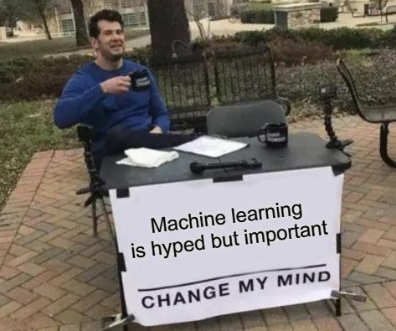
EML Outline
[Session 1, 09-10h30] Introduction to ML
[Session 2, 11-12h30] Intermediate ML
[Session 3, 14-15h30] Advanced ML
Everywhere
Where is the EVOLUTIONARY part?
Notes:
How many of you are PhD students?

Slide 5
What is Machine Learning?
You have data, and information on the data
You’d like to have a predictive model
Classical approach
Develop ad-hoc algorithm with human knowledge
Machine Learning (ML) approach
Use generic (existing) algorithm, able to…
…extract and reproduce information from data
…provide predictions for unseen data
Notes:
You want to create a model; you want to get information from the data

Slide 6
What is Machine Learning?
Restate learning task as optimization task
Solve the optimization task relying on data
Learning Task
Optimization Task
Notes:
Machine learning, at its core, it’s very simple. The complex part is in the details of each algorithm.

Slide 7
What is Machine Learning?
A more proper definition
Given a class of tasks T, a performance measure P, and experience E, a machine learning algorithm improves its performance measured with P, for tasks in T, using the experience E

Slide 8
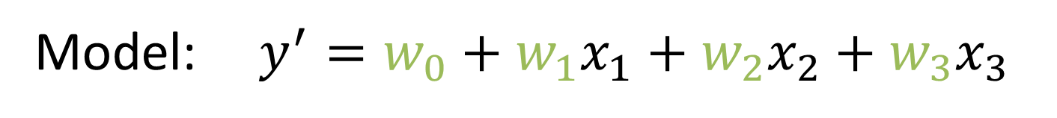

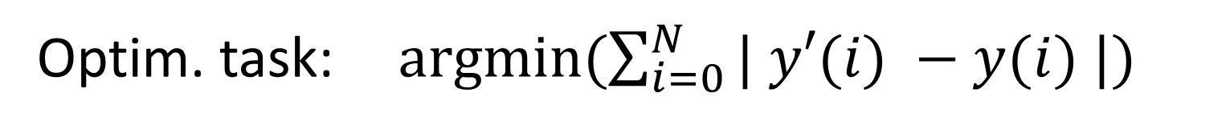
Example: “Linear Regression”
Learning Task: learn a linear model that fits the experimental data
Optimization Task: find coefficients that minimize error w.r.t. experimental/known data
Variables: $y, x_{1},x_{2},x_{3}$
Model: $y^{′}=w_{0}+w_{1}x_{1}+w_{2}x_{2}+w_{3}x_{3}$
Optim. task: $argmin(\sum_{i=0}^{N}{| y′(i) −y(i) |)}$

Slide 9
Applications of Machine Learning
Typical uses (~90% of ML)
Classification (assign samples to known classes)
Regression (approximate an unknown function)
Clustering (define classes for unlabeled data)
Reinforcement Learning (agents learn behavior)
There are many others
Transcription, Machine translation, Anomaly detection, Dimensionality reduction, …

Slide 10
ML Taxonomy
Supervised ML (labeled training data)
Classification, Regression
Unsupervised ML (unlabeled data)
Clustering, Dimensionality Reduction
Reinforcement Learning (agent behavior)
Lots of recent popularity
AlphaGo, AlphaZero (Google stuff)

Slide 11
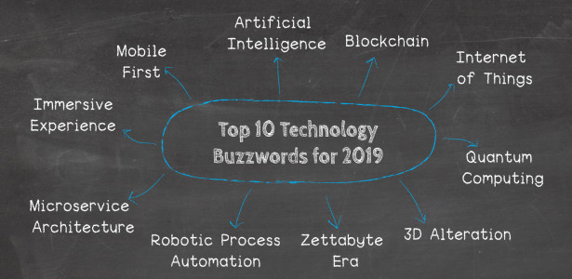
Is ML a Buzzword?
Yes.
However, it’s also a POWERFUL concept
Extremely different algorithms can be compared
Linear regression, deep learning, random forest...
Use the same metrics for everything!

Slide 12
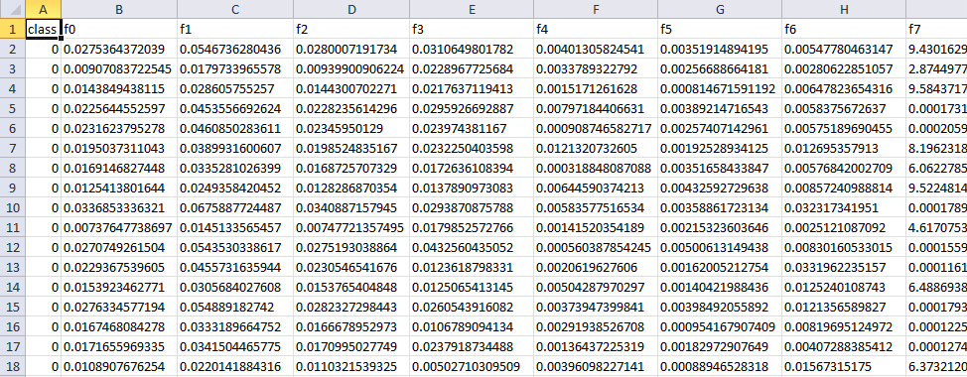
(Supervised) ML Terminology
LABEL, TARGET, y
FEATURES, X
SAMPLES
Predictive model f: y = f(X)

Slide 13
(Supervised) ML Terminology
Anything that can be transformed into numbers can be a feature!
Pixels? Yes! (values R,G,B in 0-255)
Sound? Yes! (analyzed as time series)
Written words? Yes! (Natural Language Processing is a huge part of ML, use dirty tricks)

Slide 14
Classification
Samples associated to discrete labels (classes)
Association is based on features
Ok, but HOW? -> Decision boundaries
Classifiers will find decision boundaries
Explicitly (equation of a hypersurface)
Implicitly (similar to «if x₁>2.4 and x₂<0.1, then C»)

Slide 15
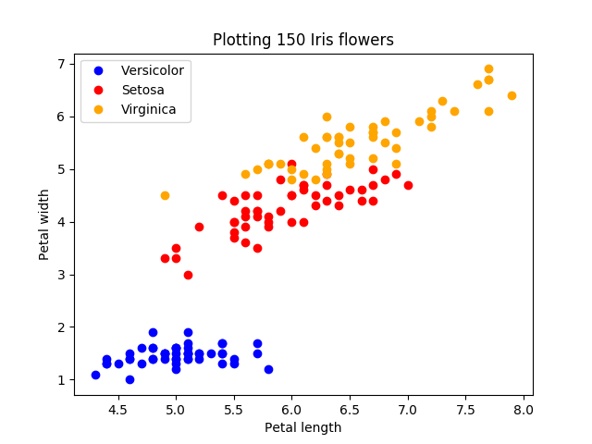
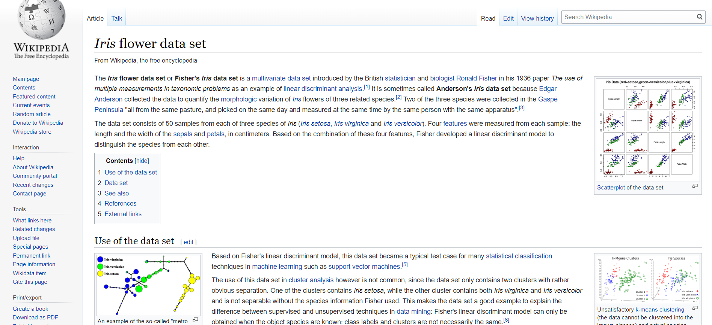
Example: Picking Flowers

Slide 16
Example: Picking Flowers
y = x * m + k
(Petal width) = (Petal length) * m + k
Unknown flower: use line to decide

Slide 17
Example: Picking Flowers
Flowers are too similar, we will make mistakes!
Sometimes the problem is harder!

Slide 18
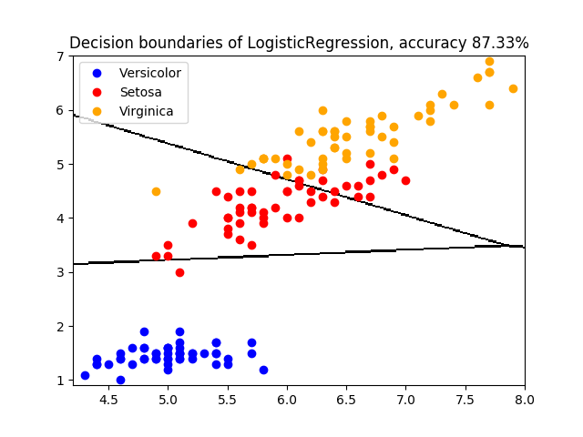
Example: Picking Flowers

Slide 19
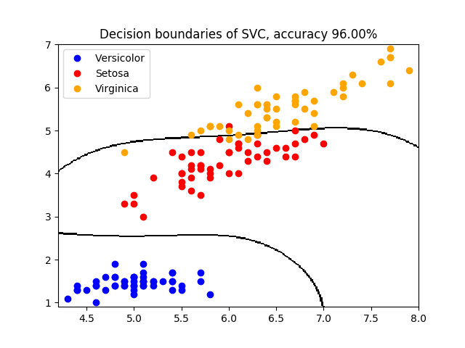
Example: Picking Flowers

Slide 20
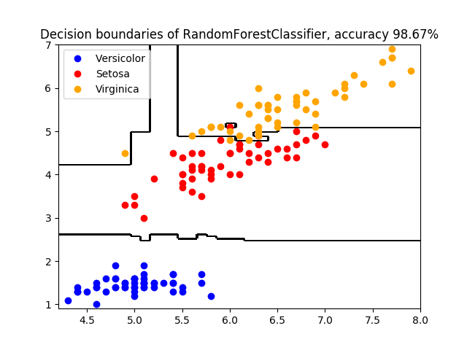
Example: Picking Flowers

Slide 21

Example: ML from Tragedy
Titanic passenger dataset from OpenML
Features: name, sex, age, fare, cabin, ...
Label/Target/Class: survived/did not survive
Experiments on the code!
Notes:
Lots of content stolen from an online tutorial

Slide 22
Example: ML from Tragedy
A few words on the Python module(s)
Scikit-learn
Implements ML objects with same interface
.fit(X, y) -> learns from features X and target y
.predict(X) -> predicts target for features X
(most of them) .feature_importance
Keras for neural networks (similar interface)
Matplolib (plots), Pandas (manage datasets)

Slide 23
Example: ML from Tragedy
What does the code do?
Loads relevant libraries
Loads data, divides data into y and X -> y = f(X)
Pre-processing on data (translate categorical into numerical, normalize everything)
Trains classifier, then tests its accuracy

Slide 24
Example: ML from Tragedy
What do you have to do?
Pick (uncomment) a classifier, any classifier
Run the code once, look at the results
Uncomment another classifier, manipulate the parameter(s) exposed by the classifier
Look at the quality of the results
Experiment with parameters and classifiers, try to improve classification accuracy

Slide 25
Example: ML from Tragedy
What did you notice?
Maximum classification accuracy?
Now, let’s try a k-fold cross-validation
«Is my algorithm good for this problem?»
Divide data into k groups (k=10 in this case)
For k times, train on all folds except k-th, test on k-th fold, take average classification
Keep same parameters; what do you observe?

Slide 26

Example: ML from Illness
Diabetes dataset, a regression benchmark
Features are measurement related to a person with diabetes (age, BMI, blood tests...)
Target is a quantitative illness progression

Slide 27
Example: ML from Illness
What do you have to do?
Pick (uncomment) a regressor, any regressor
Run the code once, look at the results
Try another regressor, manipulate the parameter(s) exposed by the regressor
Look at the quality of the results
Experiment with parameters and regressor, try to improve R2

Slide 28

Overfitting
ML model has been trained on data
It fits the training data really well
It DOES NOT generalize for unseen data
The trained model captures unique properties of the training data…
…that only exist for those data

Slide 29


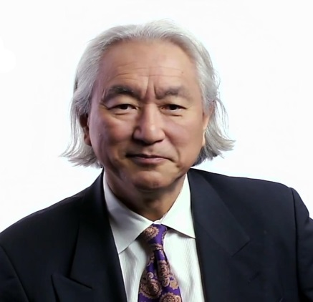
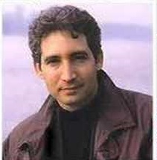
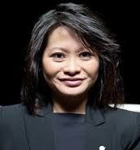
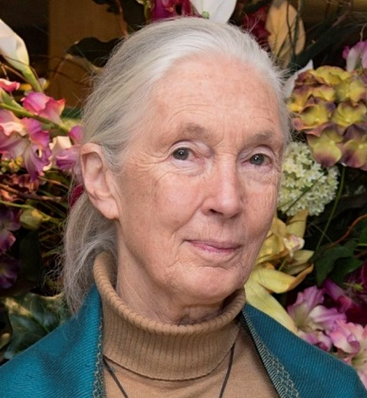
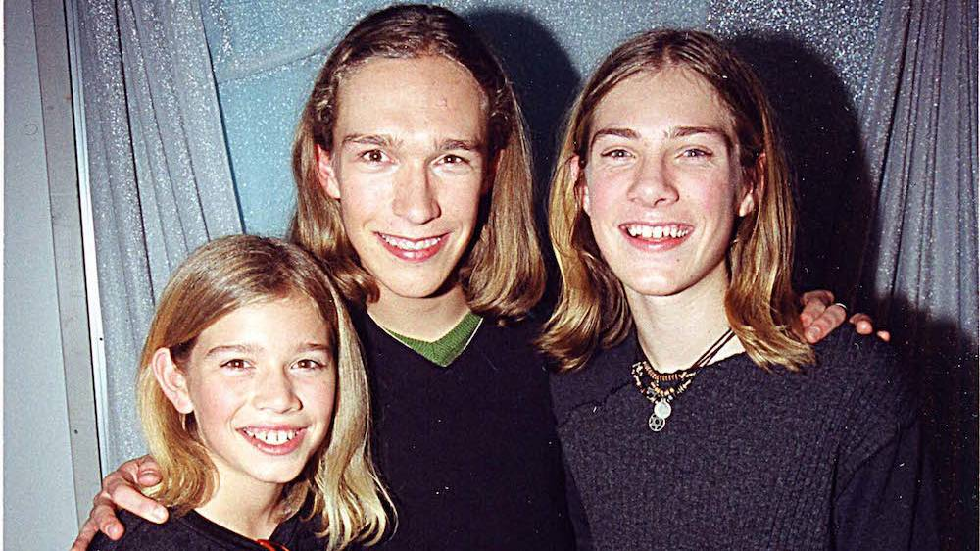
Overfitting
Example: classification man/woman
Notes:
Here the issue is that the training algorithm will recognize people with long hair as women; it will fail in the case of Hanson :-D

Slide 30
Overfitting
Assessing overfitting is really hard
In theory, you should test on unseen data
But it’s data that you do not have!
A k-fold cross-validation helps, but there are limits
Compromise between complexity and fitting
«More complex» algorithms tend to overfit
«Complexity», meaning depends on algorithm
Similar to bias vs variance

Slide 31
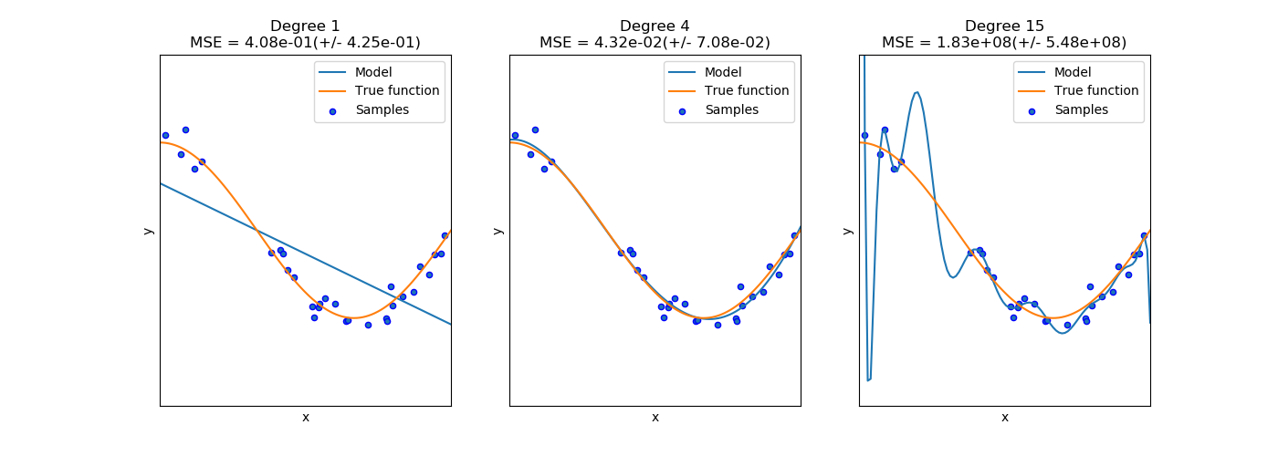
Overfitting

Slide 32
A Few Words on the Algorithms
Our objective is to find decision boundaries (or functions, in the case of regression)
There are several ways
Explicit hypersurfaces (SVM, Logistic)
Decision tree
Ensembles of decision trees (Random Forest, Bagging, Adaptive Boosting, ...)

Slide 33
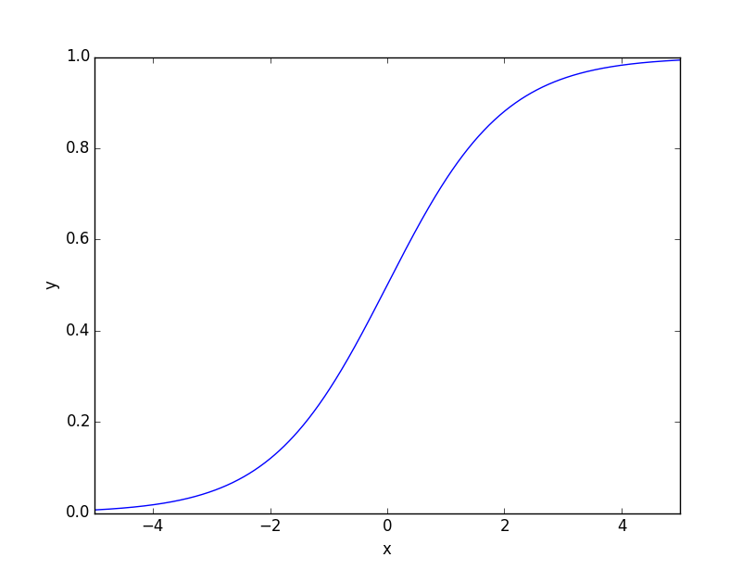
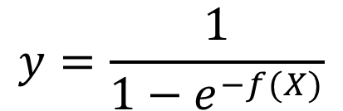
Logistic Regression
Simple, but quite effective
Explicit hypersurface equation (apparently linear)
Logistic function to reduce output to 0/1
Given a logistic model, find parameters (gradient descent or similar)
$$y=\frac{1}{1−e^{−f(X)}}$$
$$f\left(X\right)= β_{0}+x_{1}∗β_{1}+…+x_{n}∗β_{n}$$

Slide 34
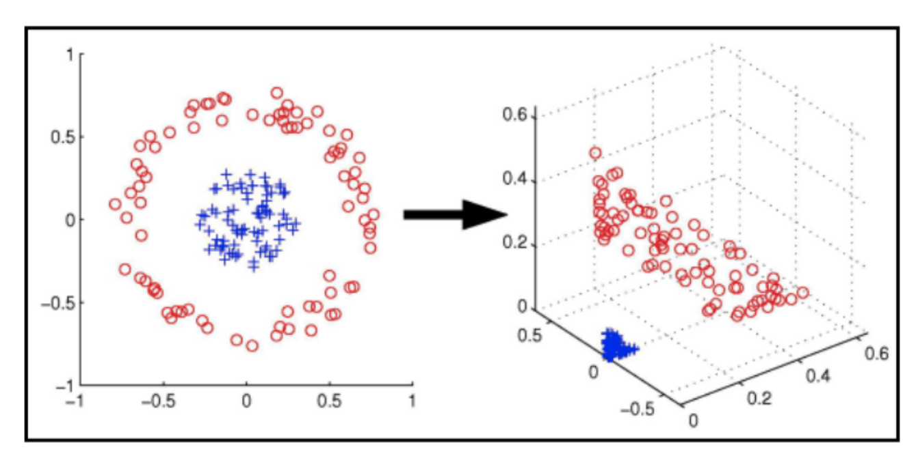
Support Vector Machines
Linear model in a higher dimensional space
New dimensions are combinations of features
Result is non-linear in original feature space

Slide 35

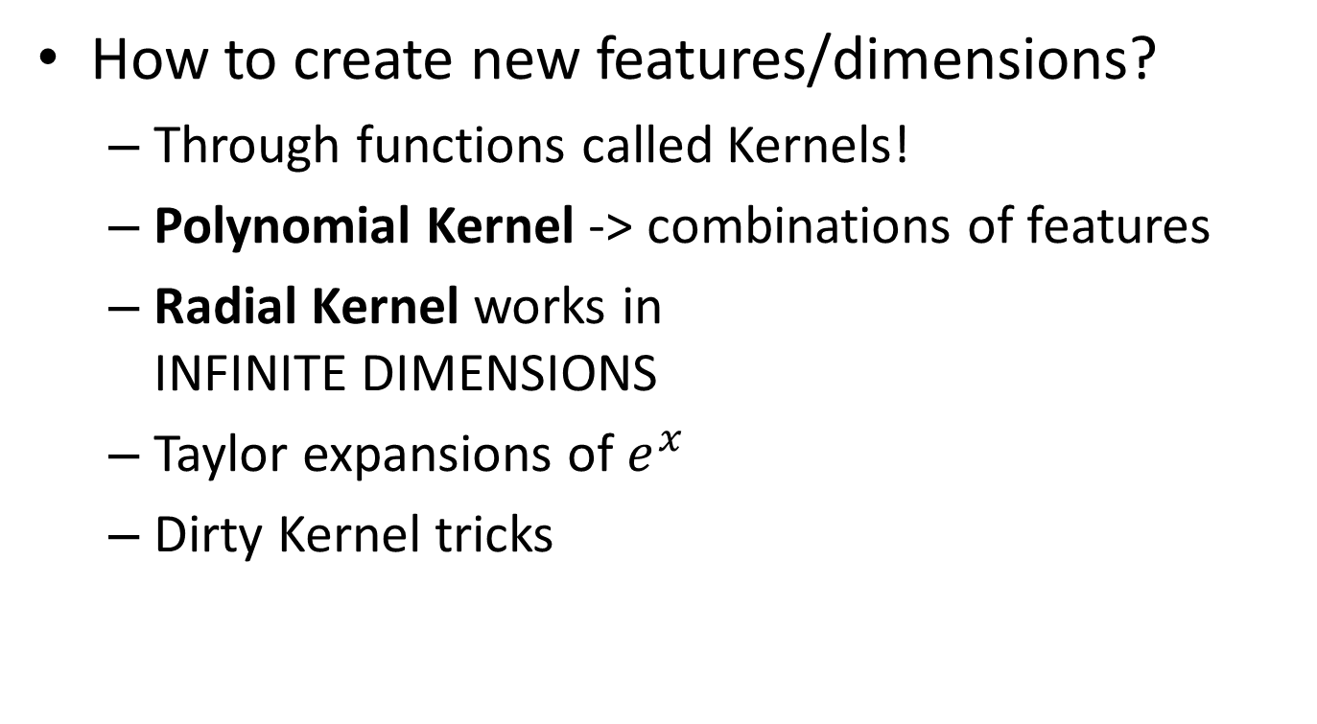
Support Vector Machines
How to create new features/dimensions?
Through functions called Kernels!
Polynomial Kernel -> combinations of features
Radial Kernel works in INFINITE DIMENSIONS
Taylor expansions of $e^{x}$
Dirty Kernel tricks

Slide 36
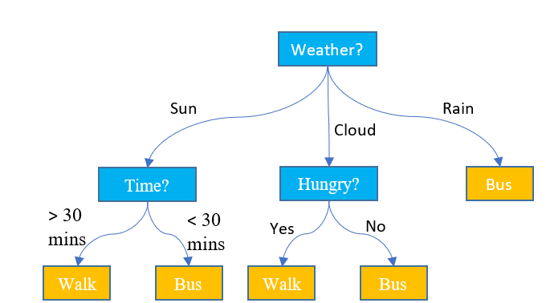
Decision Tree
Tree of depth d, with binary splits on features
Easy to read (up to a certain depth)
Deterministic algorithm
Not very effective

Slide 37
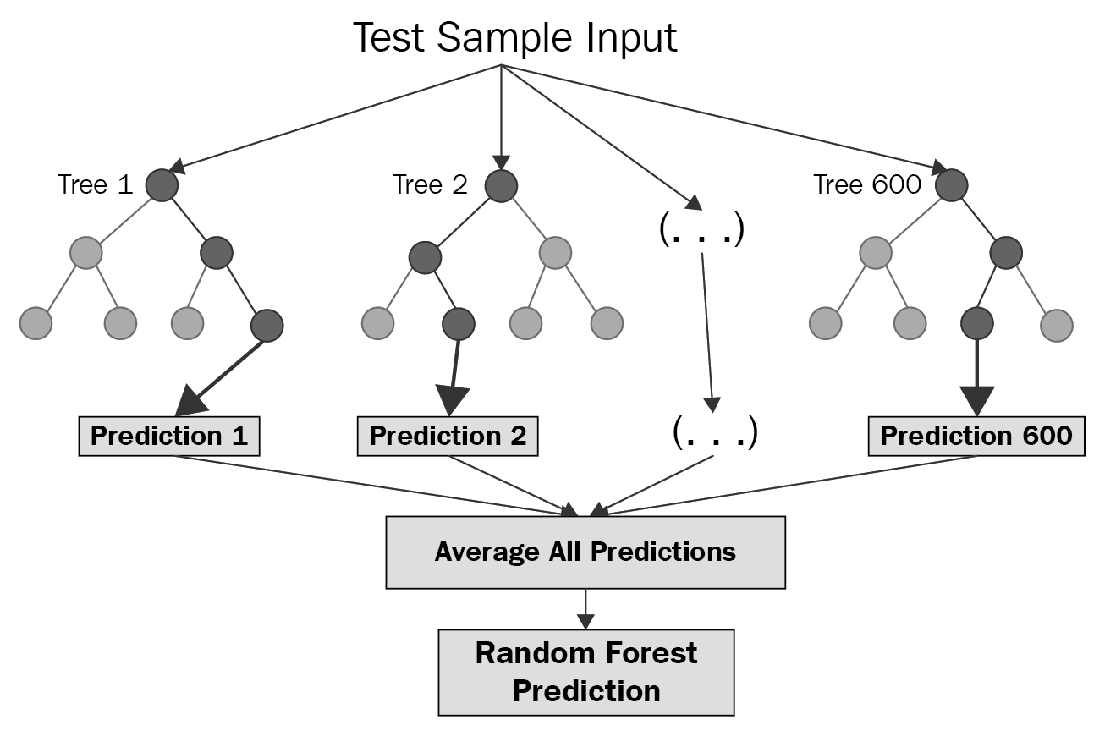
Ensembles of Decision Trees
One classifier can be wrong, but 50? 500?
Notes:
In Italy, the communist party in the 70s used to say: «Choose Communism, 500 million Chinese people cannot be all wrong!»

Slide 38
Ensembles of Decision Trees
Idea is to have specialized, weak predictors
Compensate each other’s errors
On average, they give you the good result
Different strategies
Random Forest
Bagging
Boosting

Slide 39
Random Forest
Algorithm to build a tree is deterministic
We feed different data to the algorithm
How do we select the data?
Randomly!
Pick some samples and features, remove them
Create a tree, repeat the process
Fast and surprisingly effective

Slide 40
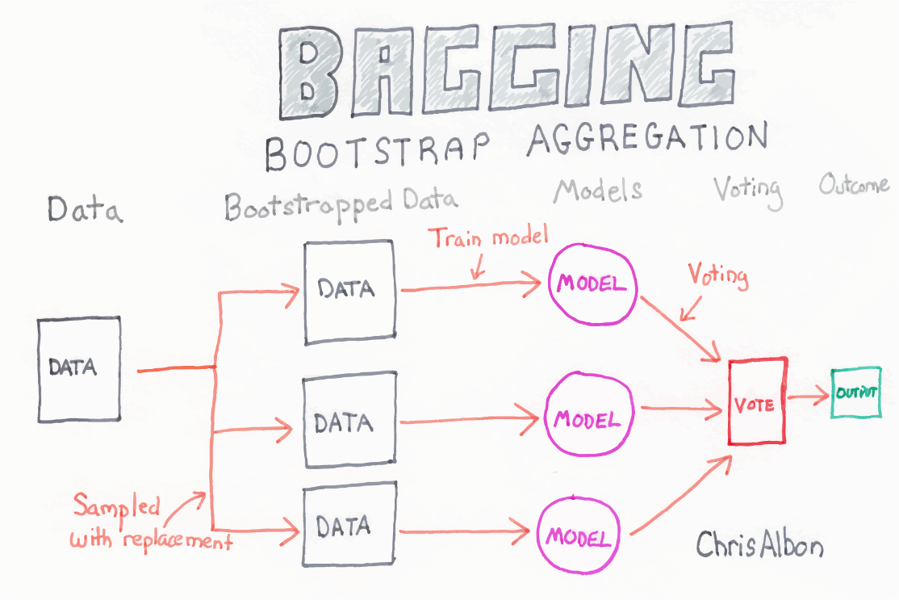
Bagging
Bagging is similar to Random Forest
However, draws samples with replacement
Same sample can be present multiple times

Slide 41
Boosting
Boosting builds highly specialized models
Associate a weight to each sample (initially, same)
Train a first decision tree
Increase weight of samples where it failed
Decrease weight of samples where it was ok
Train a second tree, using weighted cost function
Update weights, and continue
Trees can also be weighted by effectiveness

Slide 42

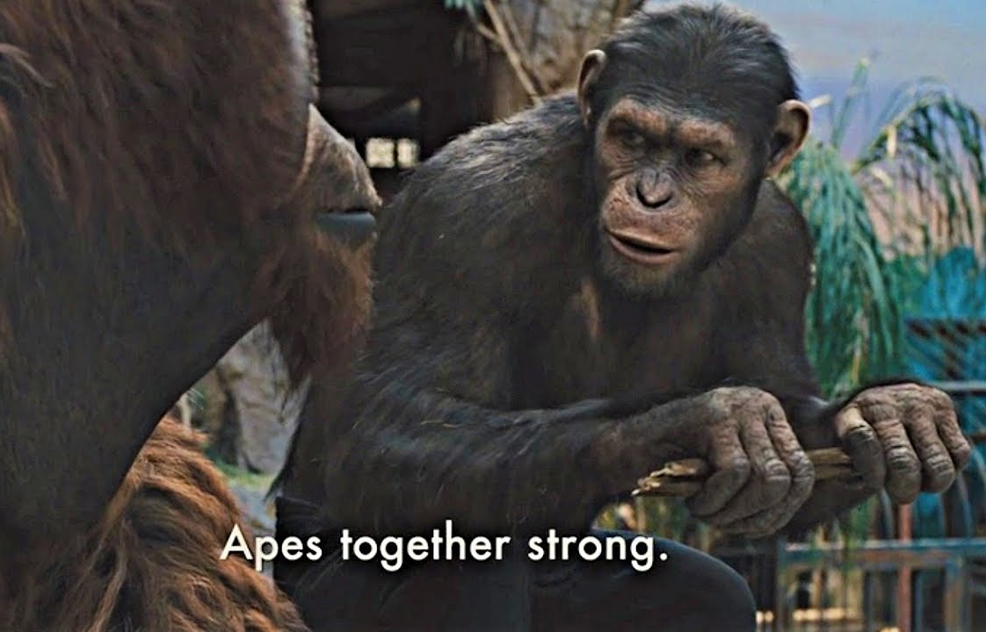
Ensembles of Decision Trees...?
Ensembles can be created out of anything
Seems complex, but it is effective
Apparently, in Kaggle, ensembles often win
Weak predictors

Slide 43
(Deep) Neural Networks
Super-simplified introduction!
Deep learning ~= Neural networks
Lots of cumulative innovations
Better ways to deal with parameter optimization
New topologies (Convolutional, LSTM, ...)
Computational resources make new stuff viable

Slide 44
(Deep) Neural Networks
…
Output layer
Input layer
…
…
…
Hidden layers
Notes:
Why should we use it?

Slide 45
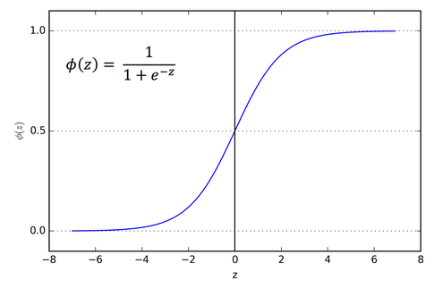
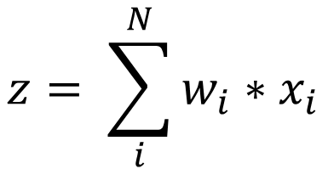
(Deep) Neural Networks
…
…
…
…
$$z= \sum_{i}^{N}{w_{i}∗x_{i}}$$
Notes:
By introducing this nonlinearity, you are able to tackle (in principle) any kind of function. The weights of each node are learned through the backpropagation algorithm and variations of gradient descent.

Slide 46
(Deep) Neural Networks
FORWARD PROPAGATION
Epochs = Iterations
Gradient descent
…
…
BACKPROPAGATION
(and variations, mostly
stochastic gradient descent)
…
…
$$z= \sum_{i}^{N}{w_{i}∗x_{i}}$$
Notes:
The system learns by optimizing the weights w_i inside each node. Broadly speaking, during the training phase first you perform a forward propagation, then you compute the difference with respect to the known values of the outputs, and then you try to backpropagate the needed modification to move the predicted values close to the known values. This procedure is usually performed using gradient descent techniques, with a lot of variations on the theme.

Slide 47
(Deep) Neural Networks
Why GD/SGD and not EAs?
Effective EAs for continuous opt. like CMA-ES
«DL Cage Match: Gradient Descent vs CMA-ES »
Turns out, they don’t need it
Mathematical analysis of search space
Lots of saddles, vanishingly few local minima
SGD can get out of saddles quite fine!
Source: Deep Learning Book

Slide 48
(Deep) Neural Networks
What is all the «Deep Learning» hype about?
It works better than anything else for images
Multiple outputs, if needed (Generative ML)
Excellent when you have LOTS of data
«Human-competitive for 5M+ samples» (DL Book)
Combinations of combinations of features
Might have a meaning!
Automatic discovery of high-level features

Slide 49
(Deep) Neural Networks
So, is the hype justified?
Yes (in part), but it’s not a good reason to use DL/DNNs everywhere
«A systematic review shows no performance benefit of machine learning over logistic regression for clinical prediction models », Christodoulou et al., 2019

Slide 50
Practical Advice
Always try as many ML algorithms as possible
Always run a (k-fold) cross-validation
Always learn normalization on training set
Remember that cross-validation is a stochastic process, average performance of two algorithms might not be significantly separable

Slide 51
Algorithms Have Parameters
ML algorithms have (LOTS of) parameters
Usually called hyperparameters
Tree depth, number of trees, optimizer, etc.
How to find the best combination of parameters for the problem?
Large search space, impossible to explore exhaustively, variables both integers and float

Slide 52
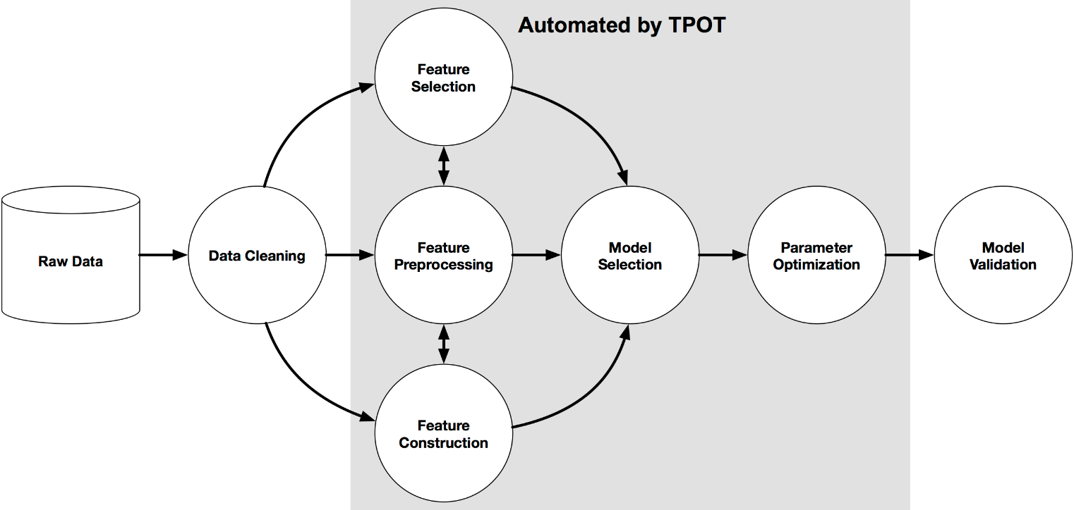
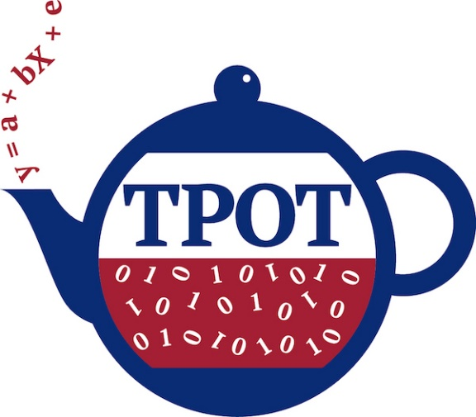
«Automated ML»
Use EAs to find the best hyperparameters!
Genetic Programming
Tree-based Pipeline Optimization Tool

Slide 53
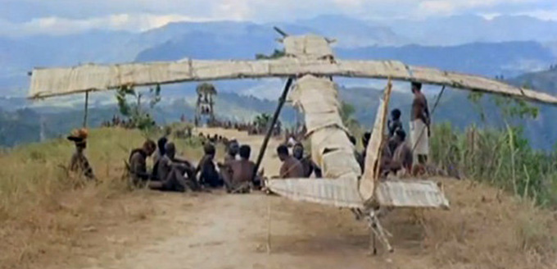
Neuro-Evolution
Motivation
Hyperparameters of DNNs are cargo science
Take a NN that worked in the past, modify it

Slide 54
Neuro-Evolution
Better approach: let an EA evolve topology
Seminal works by Risto Miikkulainen
Recent works by University of Coimbra (!)
Pros/cons
Effective but really, really, really slow (no, really)
Main issue: speed up the process
Interesting work by Travis J. Desell et al. 2019
Evolve network, train for a few epochs
Individuals inherit network parameters (!)

Slide 55

Human Understanding of ML
How is the algorithm taking its decisions?
Why is a sample associated to class A or B?
What are we doing?
Problem too complex for humans
Ask machines to solve it for us
Machines solve it
“Ok, machine, now EXPLAIN”
h00m4ns 4r3 n|_|ts!

Slide 56
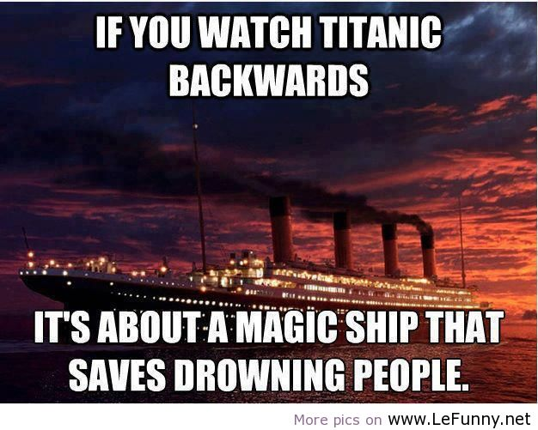
Back to the Titanic

Slide 57
Human Understanding of ML
Classifiers give us relative feature importance
Relative importance when taking decision
Run the last block of the algorithm
What are the most important variables?

Slide 58

Human Understanding of ML

Slide 59
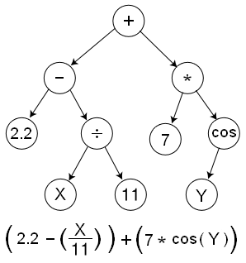
Symbolic Regression
https://www.nutonian.com/download/eureqa-desktop-download/
Symbolic Regression is EA-optimized ML
Evolve free-form equations
Population is a set of binary trees (equations)
Multi-objective: complexity vs fitting

Slide 60
Symbolic Regression
Load the datasets (Titanic and diabetes)
Run the algorithm
On both datasets
What can you observe?
Complexity/fitting
Most important features

Slide 61
EA + Human Understanding of ML
Humans understand by finding examples*
Find a few, important features
Find the best representatives of each class
All possible subsets of samples/features
Large search space
Impossible to explore exhaustively
* The best term is contrastive explanations

Slide 62
EA + Human Understanding of ML
Individual (candidate solution)
Subset of original features/samples
Fitness function(s)
Minimize number of features/samples
Minimize error (classification/mean squared error)
Multi-objective EA

Slide 63
Coreset/Prototype Set Discovery

Slide 64
Evolutionary Feature Selection

Slide 65
End of Session 1
Useful resources for PhD students
Mendeley, Zotero (Bibliographic research)
Dropbox, GoogleDrive (Data redundancy)
Overleaf, GoogleDocs (Collaborative writing)
Open Science Framework (Managing projects and collaborations)
Sci-Hub, Unpaywall (Obtain ALL THE PAPERS)

Slide 66
Session 1 Outline
General idea
Supervised ML
Classification [Example]
Regression [Example]
Unsupervised ML
Clustering [Example]
Reinforcement Learning [Example?]

